Slide 1
Boss Face Detection IoT 楊承翰 周承翰 黃俊凱

Slide 2

Gotcha !!

Slide 3




Overview
Classification
IoT Talk
Staff / Boss
Line Bot

Slide 4

Face Detection
Boss
Boss !!
Staff ?
Boss ?
Aaron
•
•
•

Slide 5
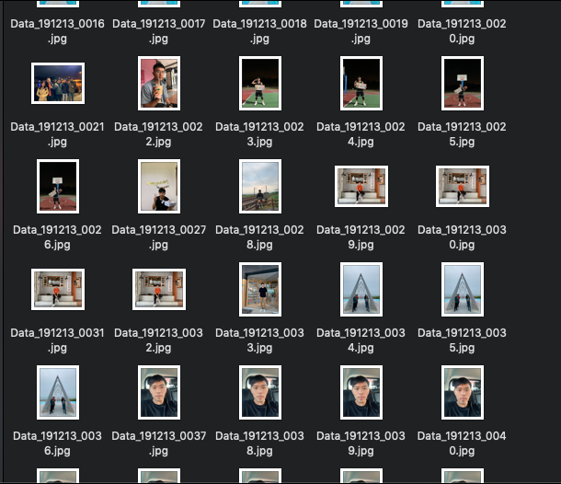
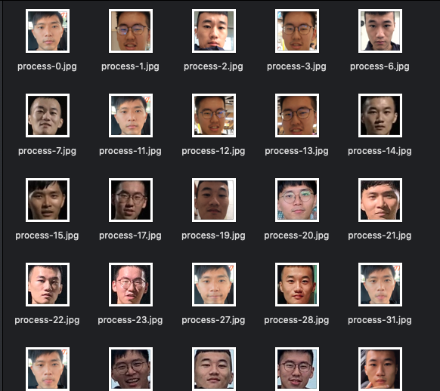
1.Collect data
Original photo :
Extract faces :
OpenCV: lbpcascade_frontalface.xml

Slide 6
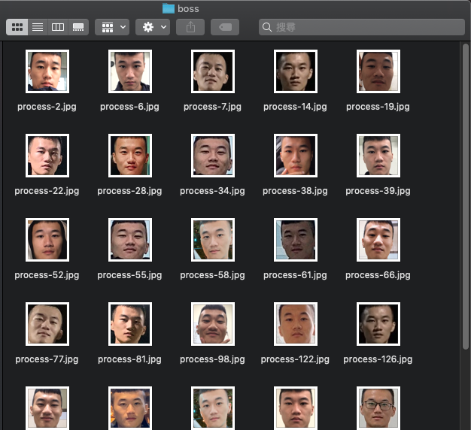
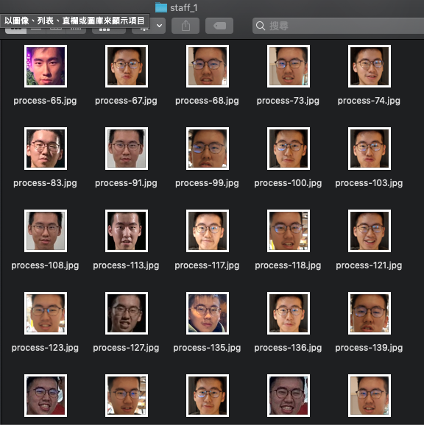
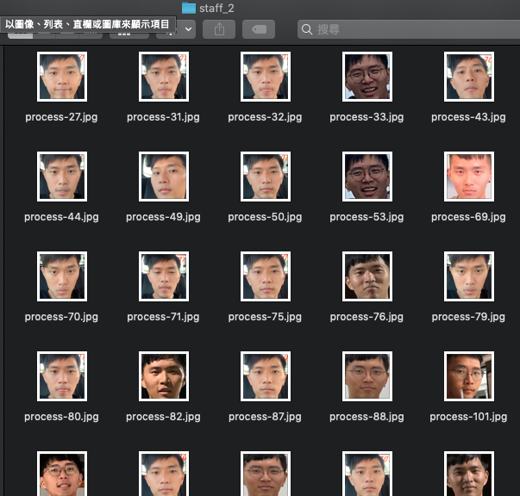
2.Classifier to file
Boss
Staff1
Staff2

Slide 7
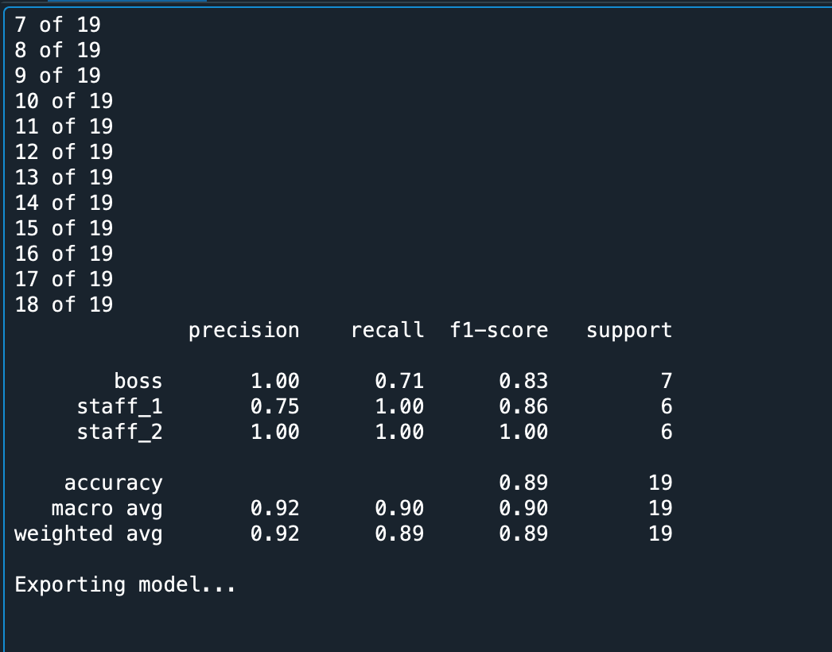
3.Training Model
Parameter
face_size = (47, 62)
batch_size = 25
test_size = 0.25
Framework
Scikit-Learn : for training process
OpenCV : for face classification
(LBPHFaceRecognizer : base on LBPH)

Slide 8
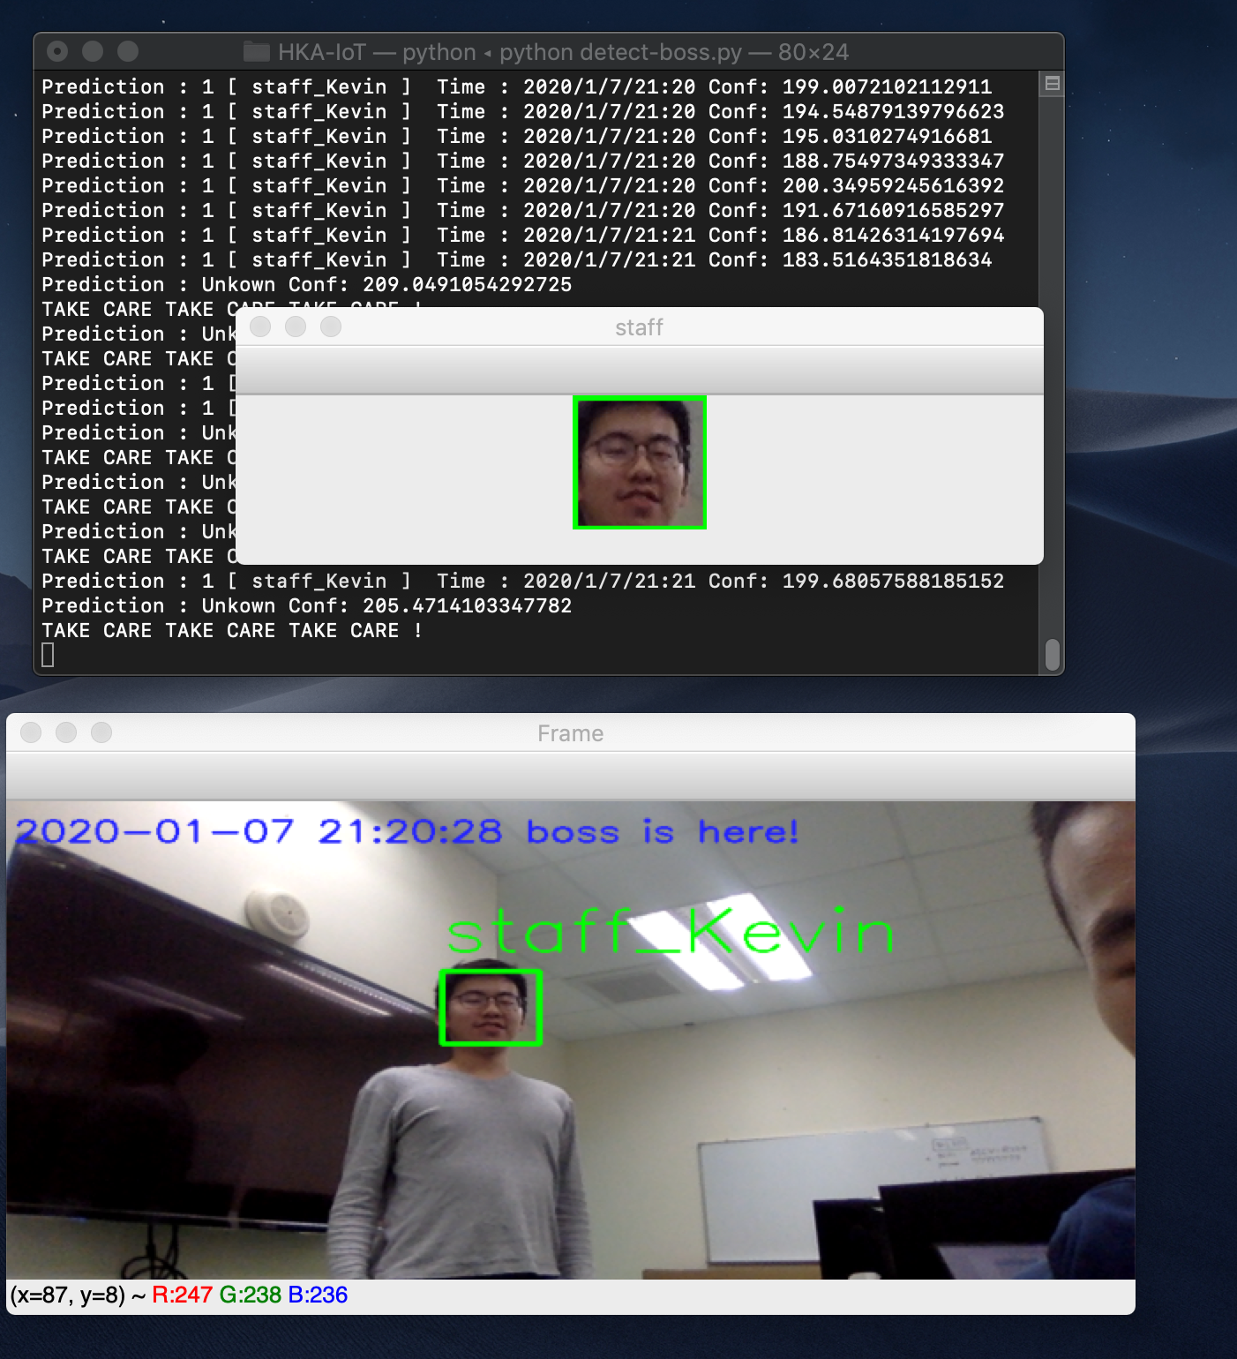
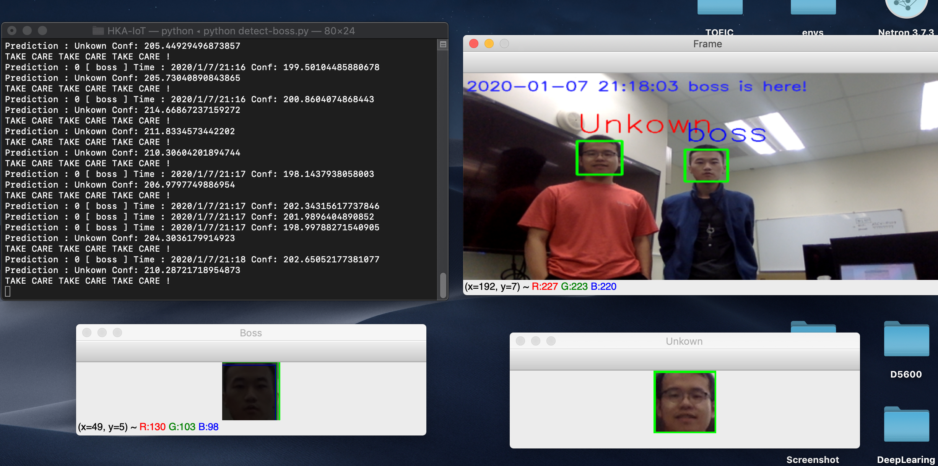
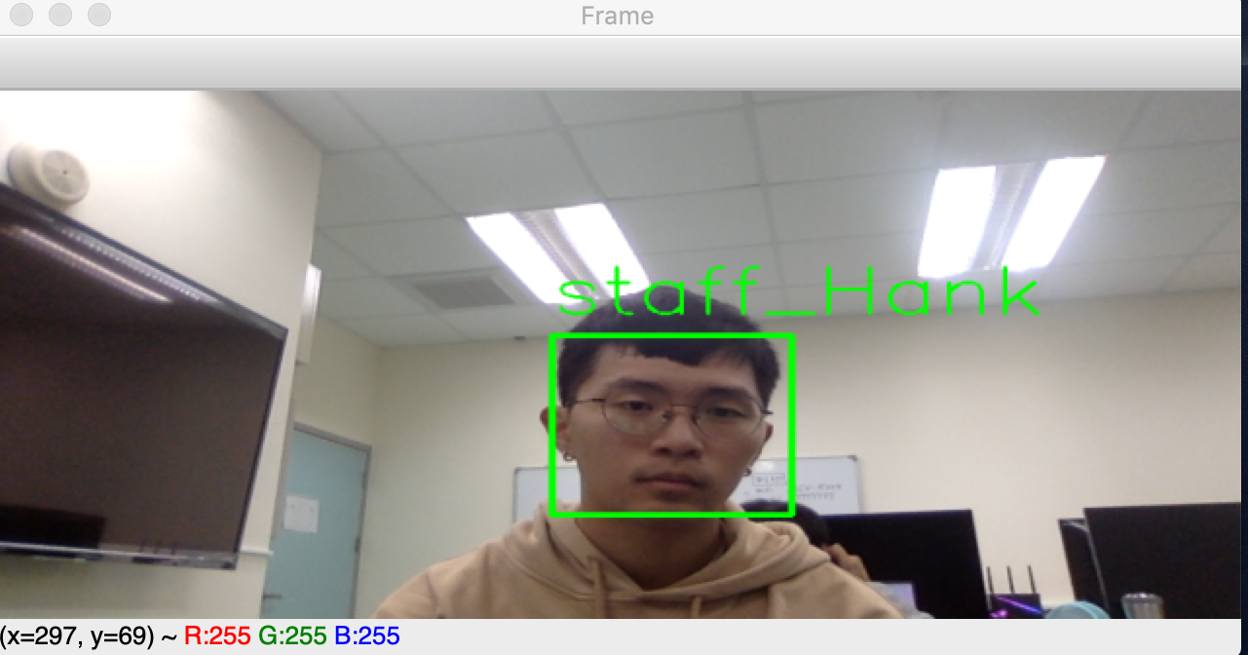
4.Testing
Demo :
1) Detection 2) Time

Slide 9
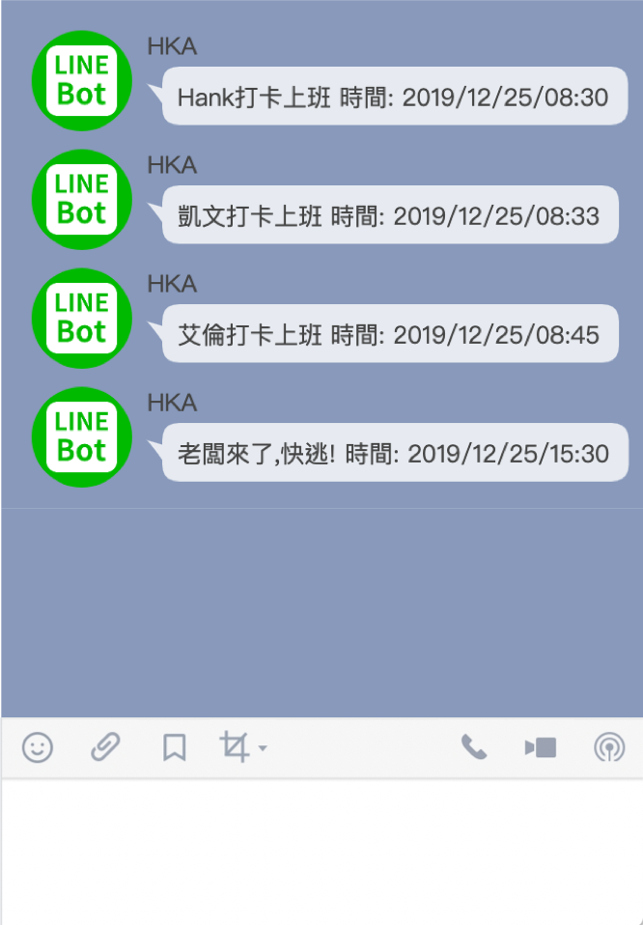

IoT Talk & Line Bot
Name
IoT Talk
Time
Line Bot

Slide 10
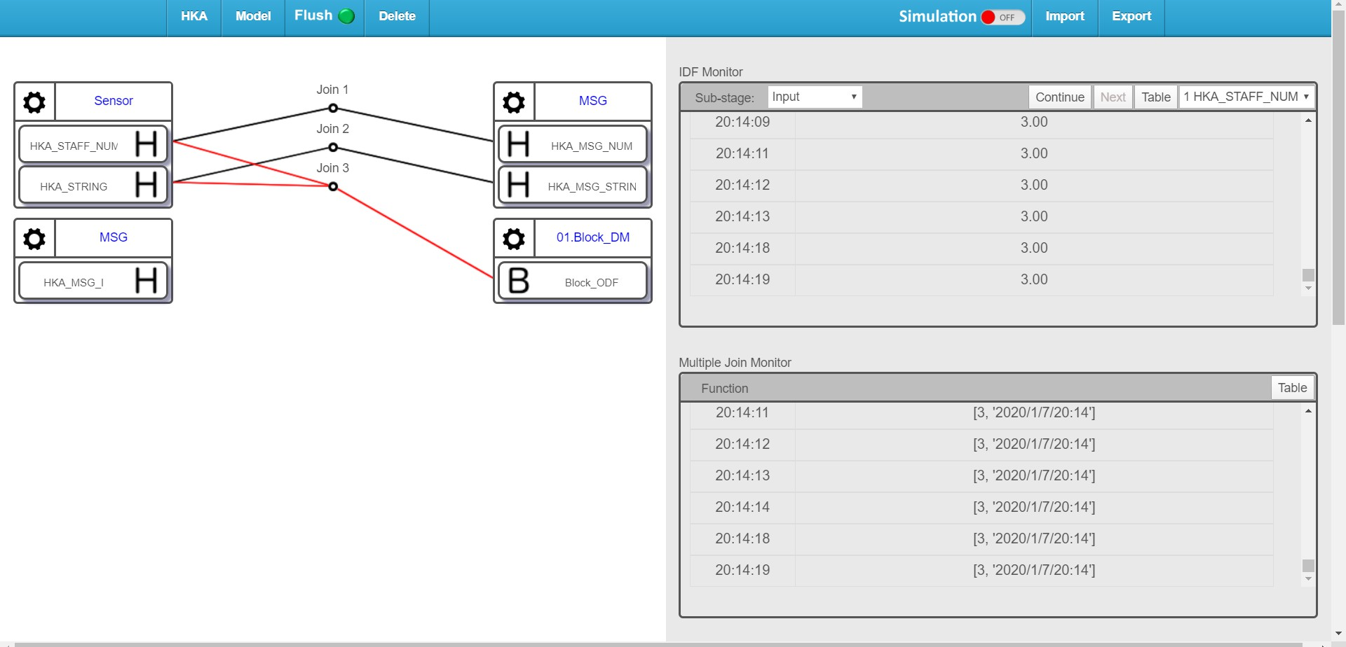
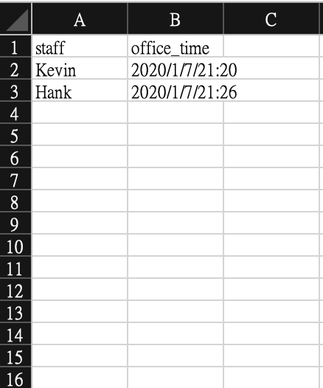
5.IoT Talk
Output to : IoTTolk & BlockChain
Sensor(IDF) : HKA_STAFF_NUM , HKA_STRING
MSG(ODF): HKA_MSG_NUM, HKA_MSG_STRING
Other Team‘s ODF: Block_ODF

Slide 11
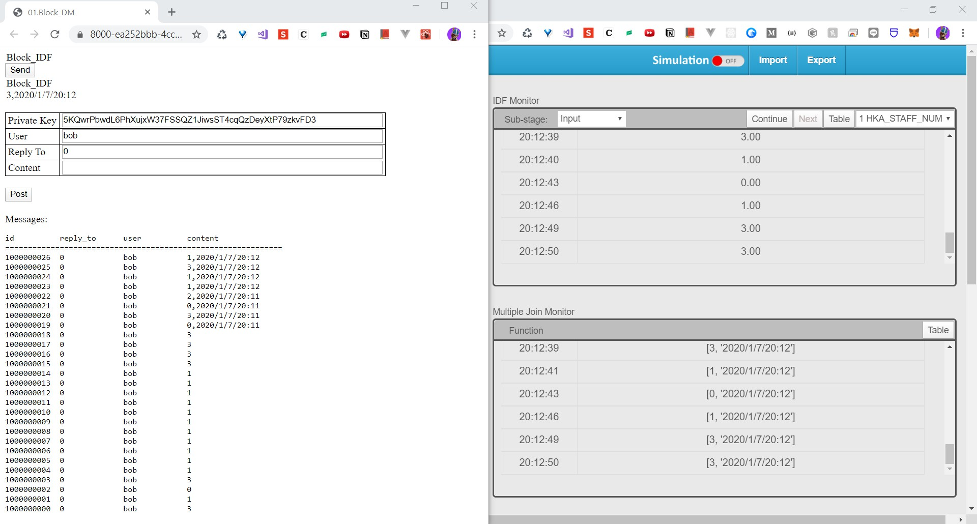
5.IoTTalk

Slide 12
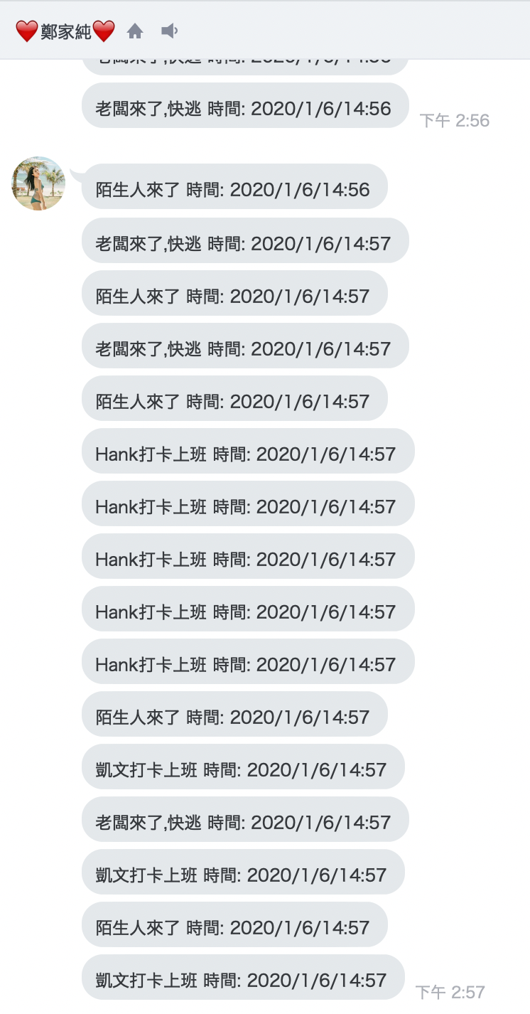
6.LineBOT

Slide 13
7.Cooperation
Face Detection : 周承翰 楊承翰
IoTTalk (Line Bot) : 黃俊凱

Slide 14
Thanks

